Slide 1
Detection of Composite signal using CDMA Transmitter
Guided By: Dr. MERLIN GILBERT RAJ S
Associate Professor
Dept ECE
KITS
Prepared BY:
Sanjay Prabu M V – URK22EC1062
Bavin B – URK22EC1038

Slide 2
Outline
Introduction
Market Survey
Methodology
Results and Discussions
Conclusions
References
Acknowledgements

Slide 3
Introduction
Code Division Multiple Access (CDMA) allows multiple users to share the same communication channel by assigning each user a unique pseudo-noise (PN) sequence or spreading code. This enables simultaneous data transmission over the same frequency band without interference, provided the codes are orthogonal.

Slide 4
Market Survey
The CDMA transmitter market grew in the 3G era, with Qualcomm as a key player, but demand has declined with the shift to 4G LTE and 5G. Telecom operators are phasing out CDMA for newer technologies like OFDMA, though it remains in niche areas like military and satellite communications.

Slide 5
Problem Statement
A secure communication system needs to be designed to transmit data in an environment prone to interference, spying, and jamming. The solution should ensure that only the intended transmitter and receiver, who share a unique spreading code, can successfully exchange information.

Slide 6
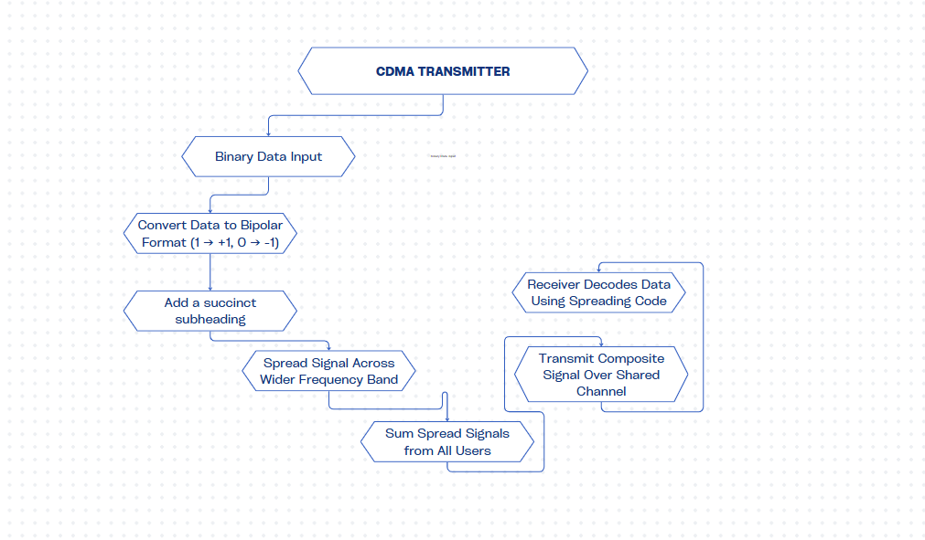
Methodology

Slide 7
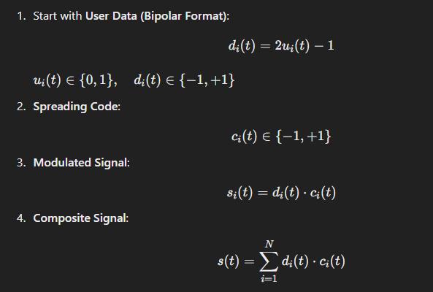
Mathematical Model

Slide 8
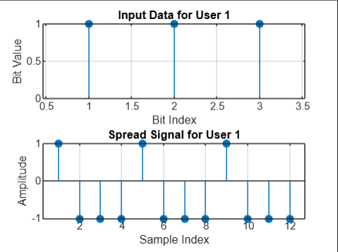
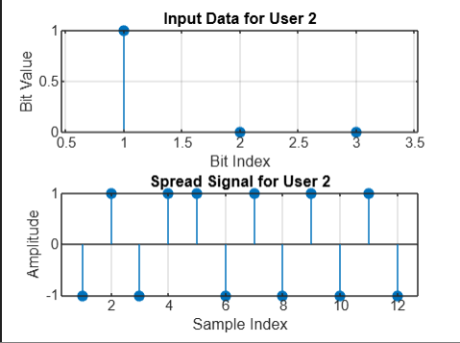
Results and Discussions

Slide 9
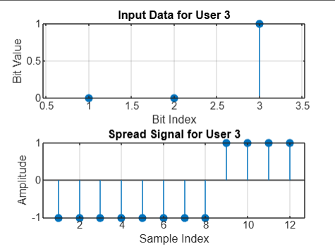
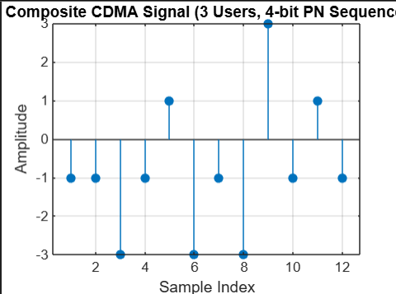
Results and Discussions

Slide 10
Conclusions
In conclusion, the CDMA transmitter allows multiple users to share bandwidth using unique pseudo-noise (PN) sequences, ensuring accurate data recovery and minimal interference. This efficiency underscores CDMA's value in wireless communication, though maintaining orthogonality of spreading codes is crucial to avoid multi-user interference.

Slide 11
References
Proakis, J. G., & Salehi, M. (2007). Digital Communications (5th ed.). McGraw-Hill.
Ali, M. A. (2019). "Performance Analysis of CDMA Systems with Different Spreading Codes." Master’s Thesis, University of Technology.
Verma, A. K., & Shukla, S. (2013). "Performance Evaluation of CDMA System Under Various Spreading Codes." International Journal of Computer Applications, 71(9), 1-6.

